Slide 1
Connected and Disconnected Travelling Salesman Problem Solver
Group Members:
21k-3187 Muhammad Maaz Siddiqui
21k-3416 Muhammad Arif
21k-4821 Lov Kumar
21k-4922 Ali Ahmed

Slide 2
Overview
Find the shortest possible route that visits a given set of cities and returns to the starting city. Optimize routes for the Traveling Salesman Problem (TSP).
Address both Connected and Disconnected TSP scenarios.
Implement and compare different algorithms for solving these problems.
Connected TSP
Visiting a set of cities with a constraint to visit each city exactly once and return to the starting city.
Disconnected TSP
Similar to Connected TSP but without the requirement to return to the starting city.

Slide 3
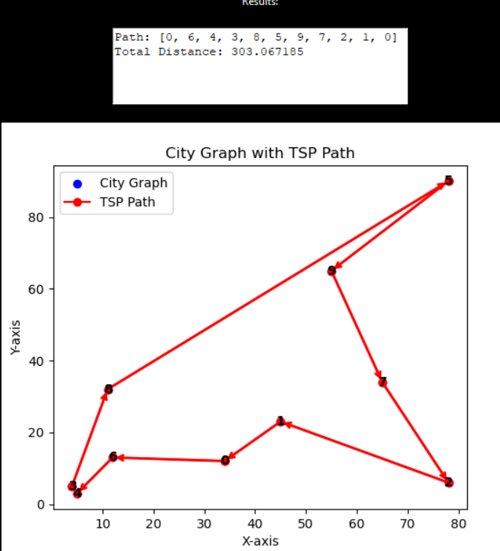
Connected (Exact TSP)
Exact algorithms for the Traveling Salesman Problem (TSP) aim to find the optimal solution, i.e., the shortest possible tour that visits each city exactly once and returns to the starting city. While these algorithms guarantee an optimal solution, they may become impractical for large instances due to their high time complexity.

Slide 4
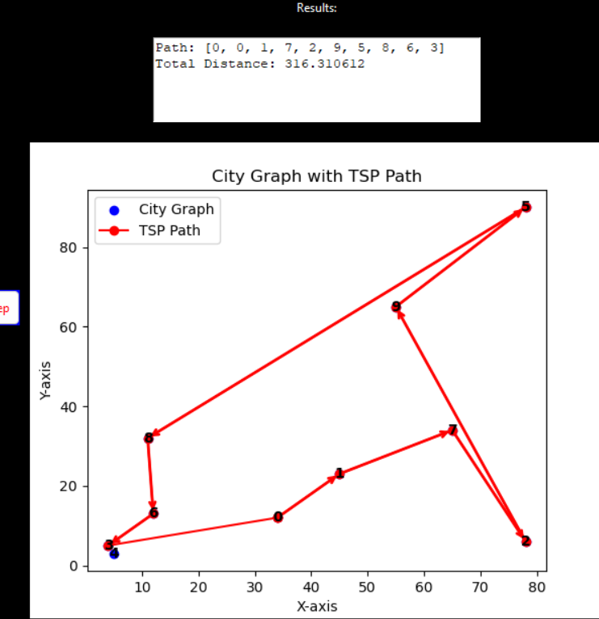
Disconnected TSP
Solving the Disconnected Traveling Salesman Problem (DTSP) involves finding an optimal or near-optimal route that visits each city exactly once, even if the cities are not all connected in a single tour.
Heuristic TSP
It is nearest neighbor Approach. Starts from a random city and, at each step, chooses the nearest unvisited city. Simple and fast, but it doesn't always guarantee an optimal solution.

Slide 5
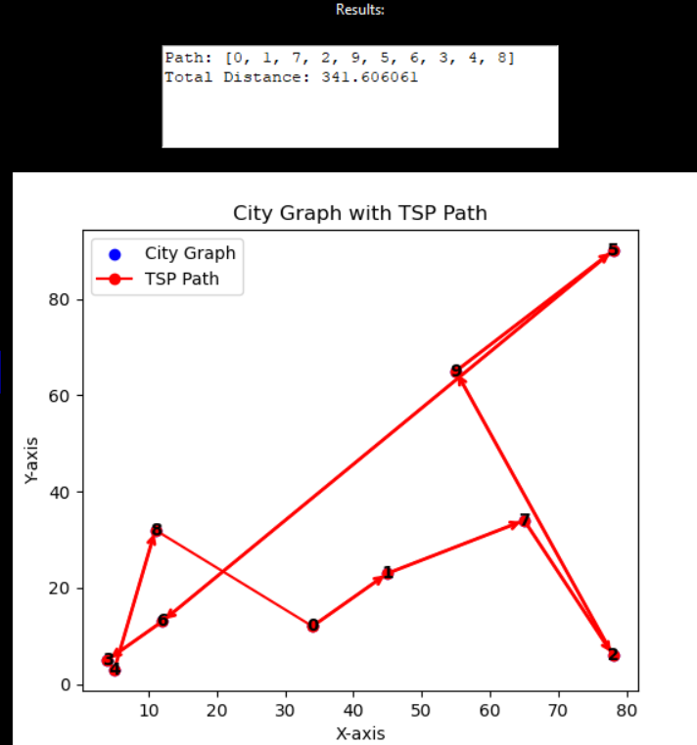
Disconnected TSP
Minimum Spanning Tree (MST) TSP
Construct a minimum spanning tree of the cities and then traverse the tree to form a tour. Examples include Prim's algorithm and Kruskal's algorithm.

Slide 6
Problem Statement
Given a set of cities and the distances between each pair of cities, find the shortest possible tour that visits each city exactly once and returns to the starting city.

Slide 7
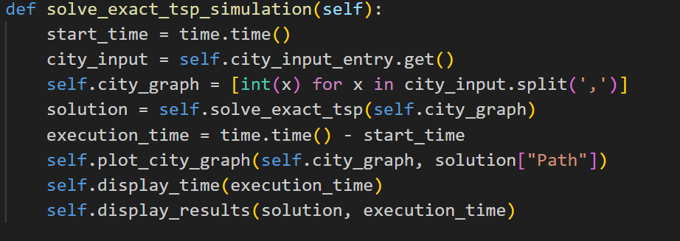
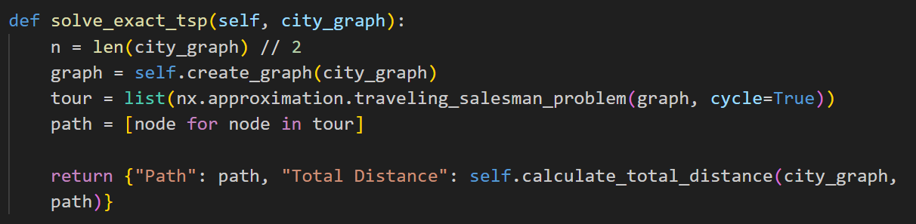
Methodology
Exact TSP

Slide 8
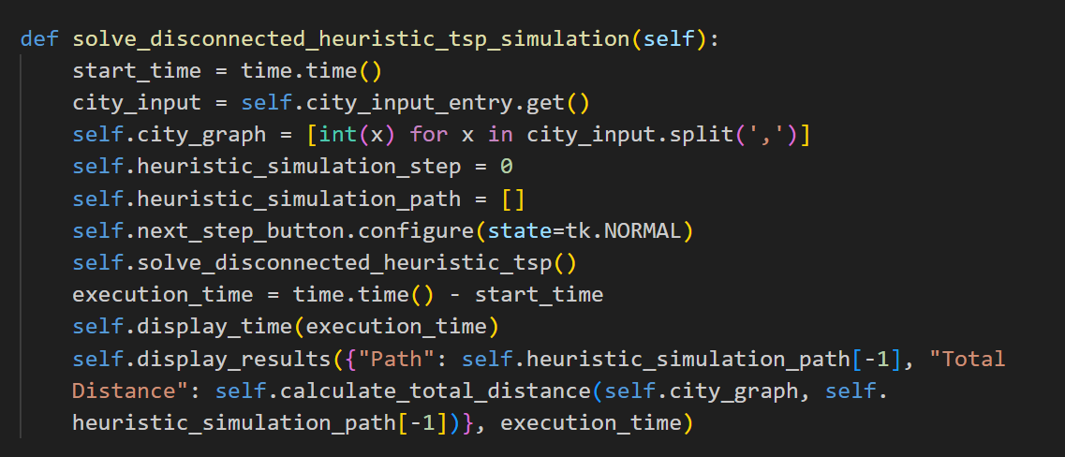
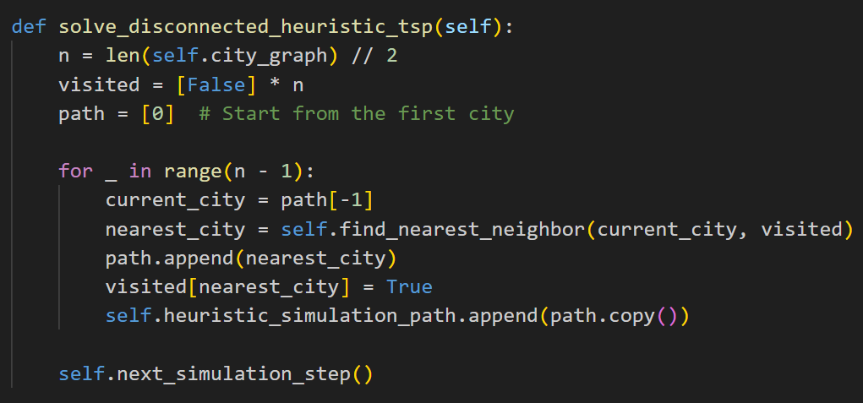
Heuristic TSP

Slide 9
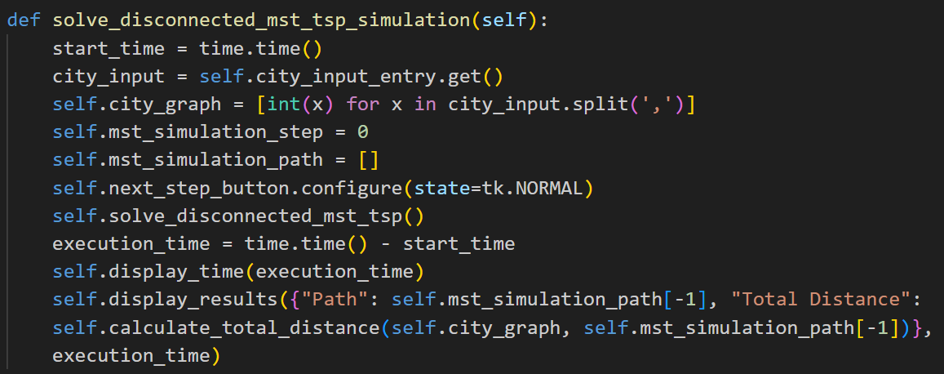
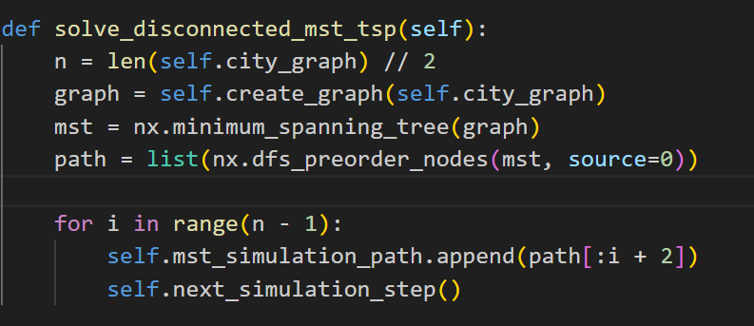
MST TSP

Slide 10
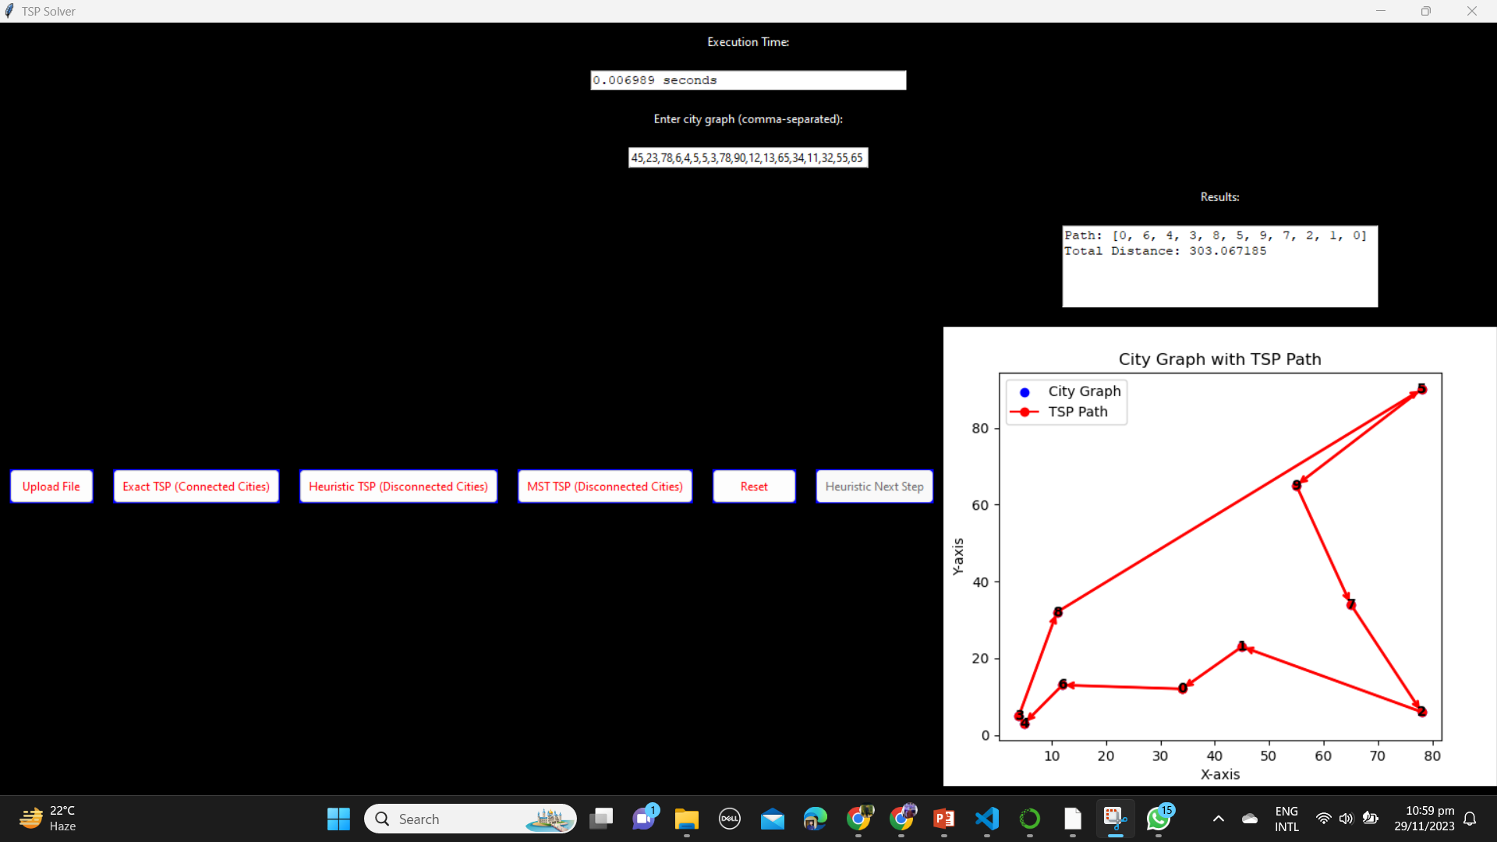
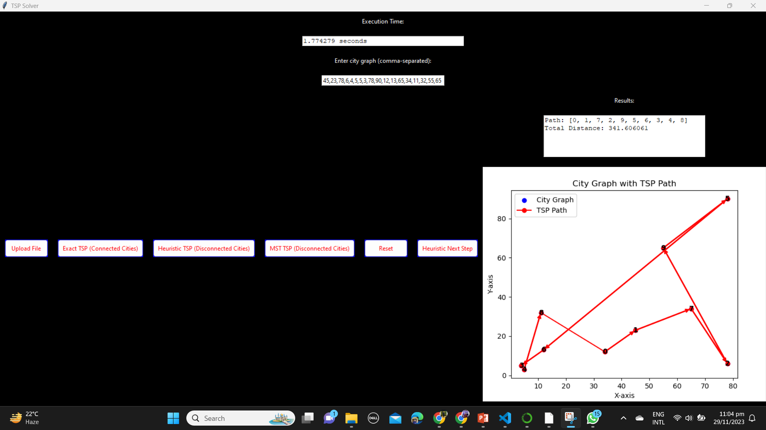
Results (including input and output) 1.Exact 2. MST TSP

Slide 11
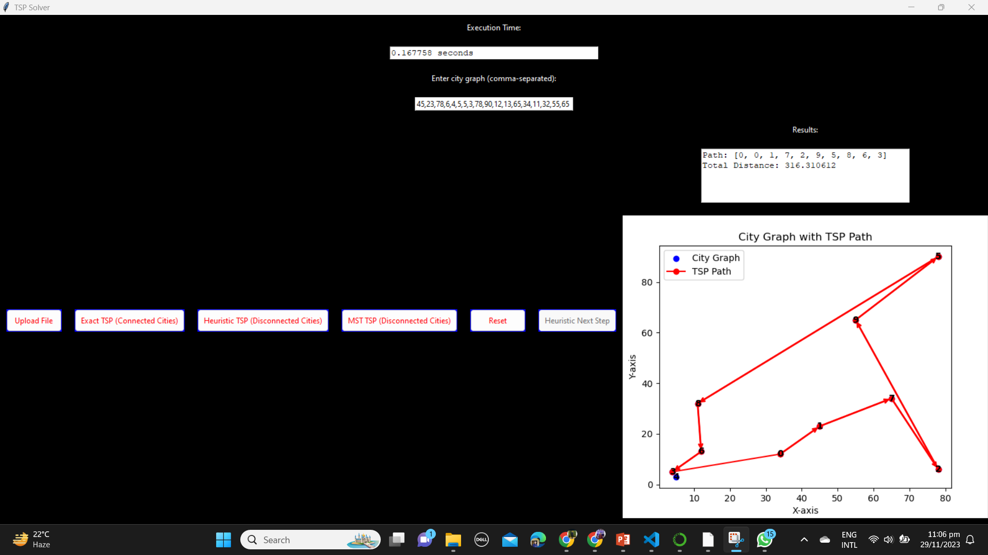
Results 3. Heuristic TSP

Slide 12
Conclusion
The Connected and Disconnected Traveling Salesman Problem Solver project aimed to find efficient solutions for route optimization. Two variants were addressed: Connected TSP, where each city must be visited exactly once and the salesman returns to the starting city, and Disconnected TSP, without the return constraint.
For small instances where finding the exact optimal solution is critical, an Exact TSP algorithm may be the best choice.
For larger instances, where computational efficiency is a priority, MST TSP algorithms or Heuristic TSP algorithms are often preferred.
The specific characteristics of the TSP instance, such as the number of cities and the structure of the distances, can influence the choice of algorithm.

